Slide 1
Parallel Programming Using C++
Atul Kahate
https://www.linkedin.com/in/atulkahate/

Slide 2
Module 1 – C++ Parallel Programming Fundamentals

Slide 3
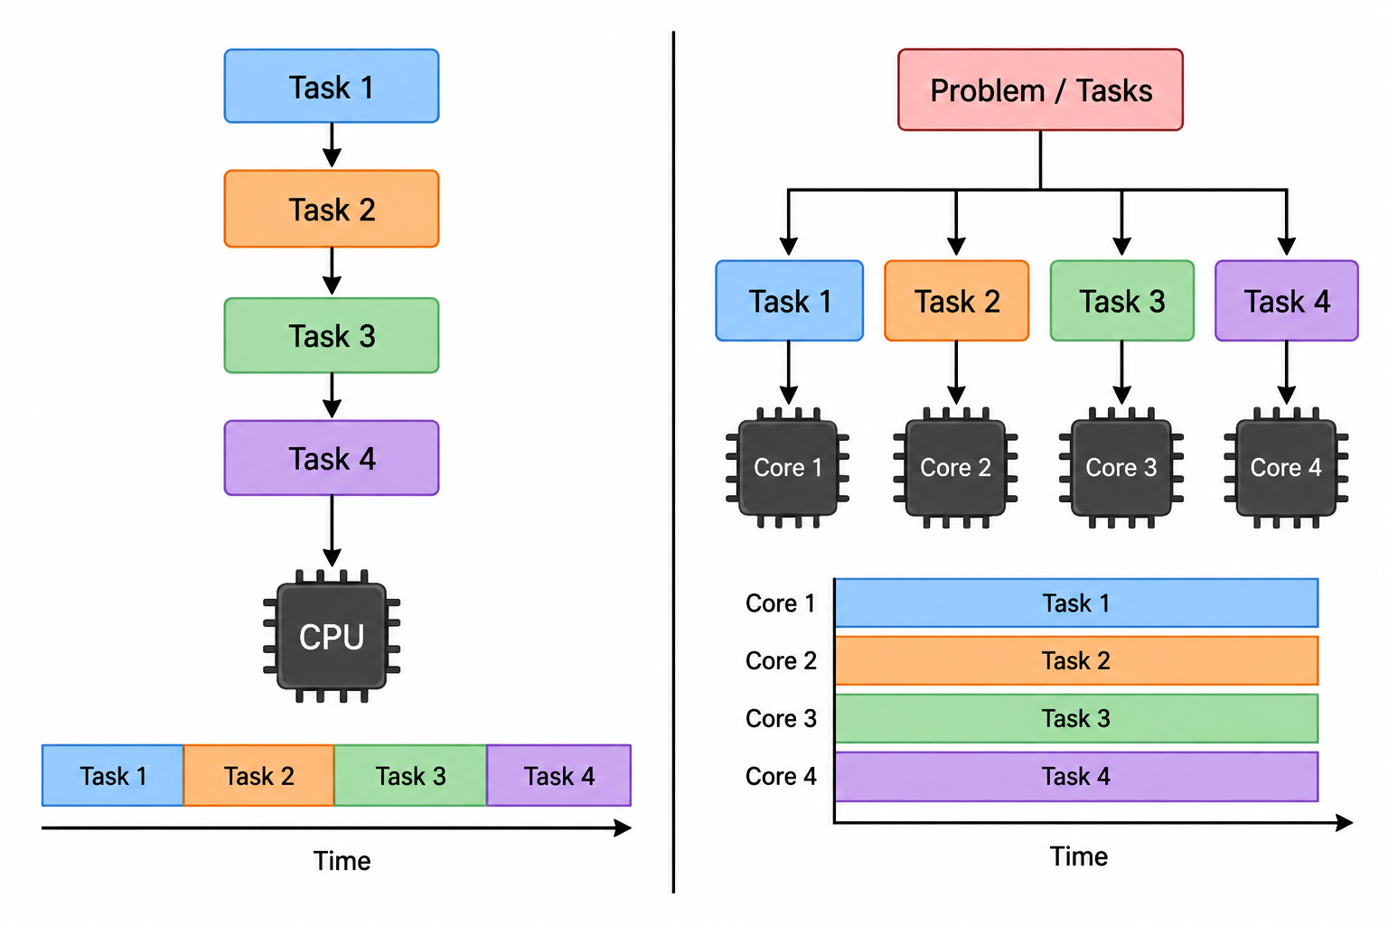
CPU Parallel Programming

Slide 4
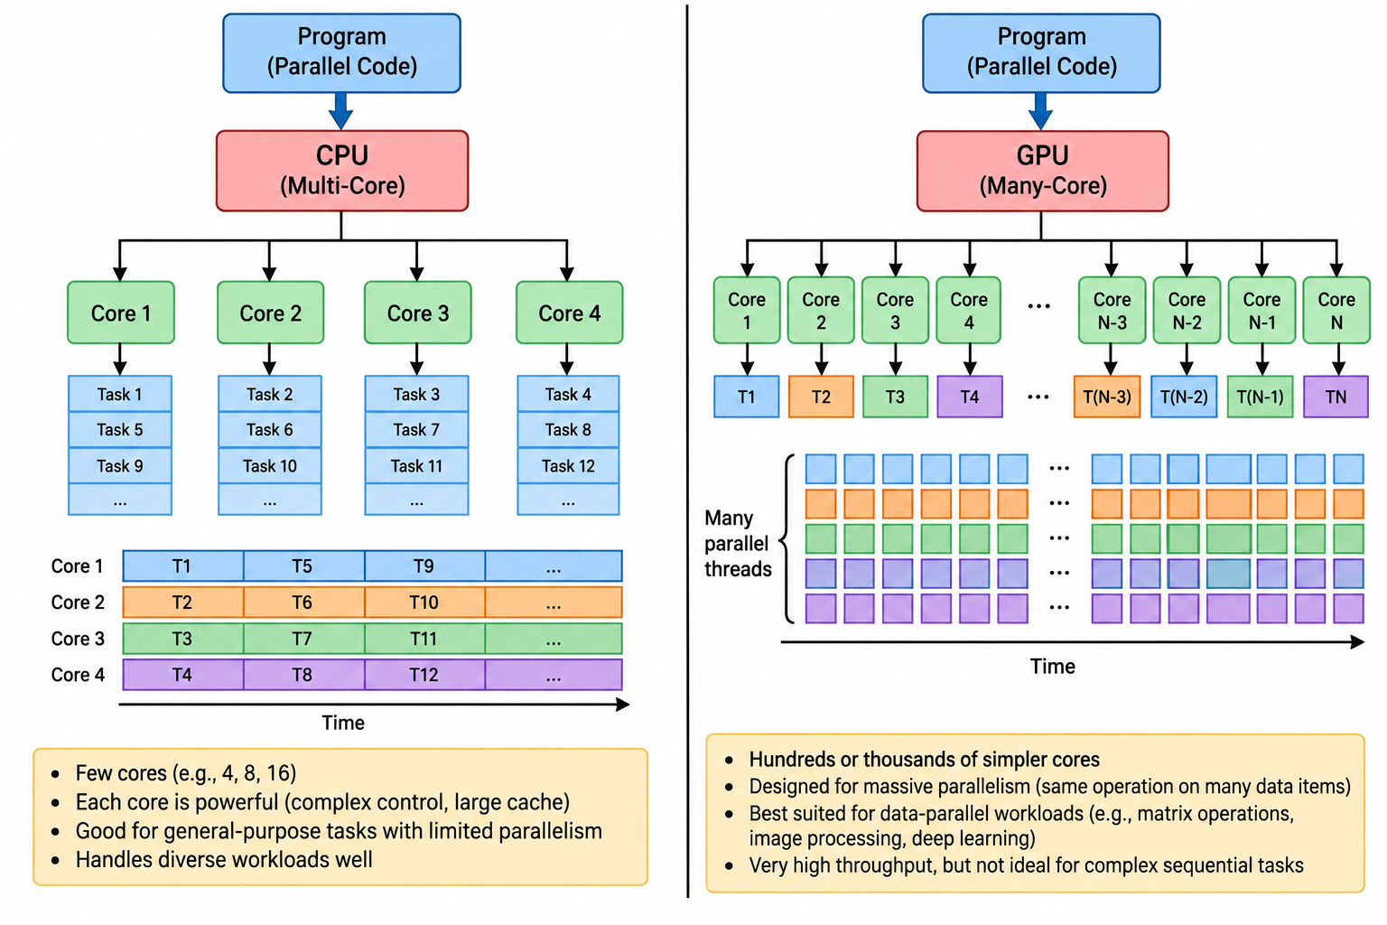
CPU and GPU Parallel Programming

Slide 5
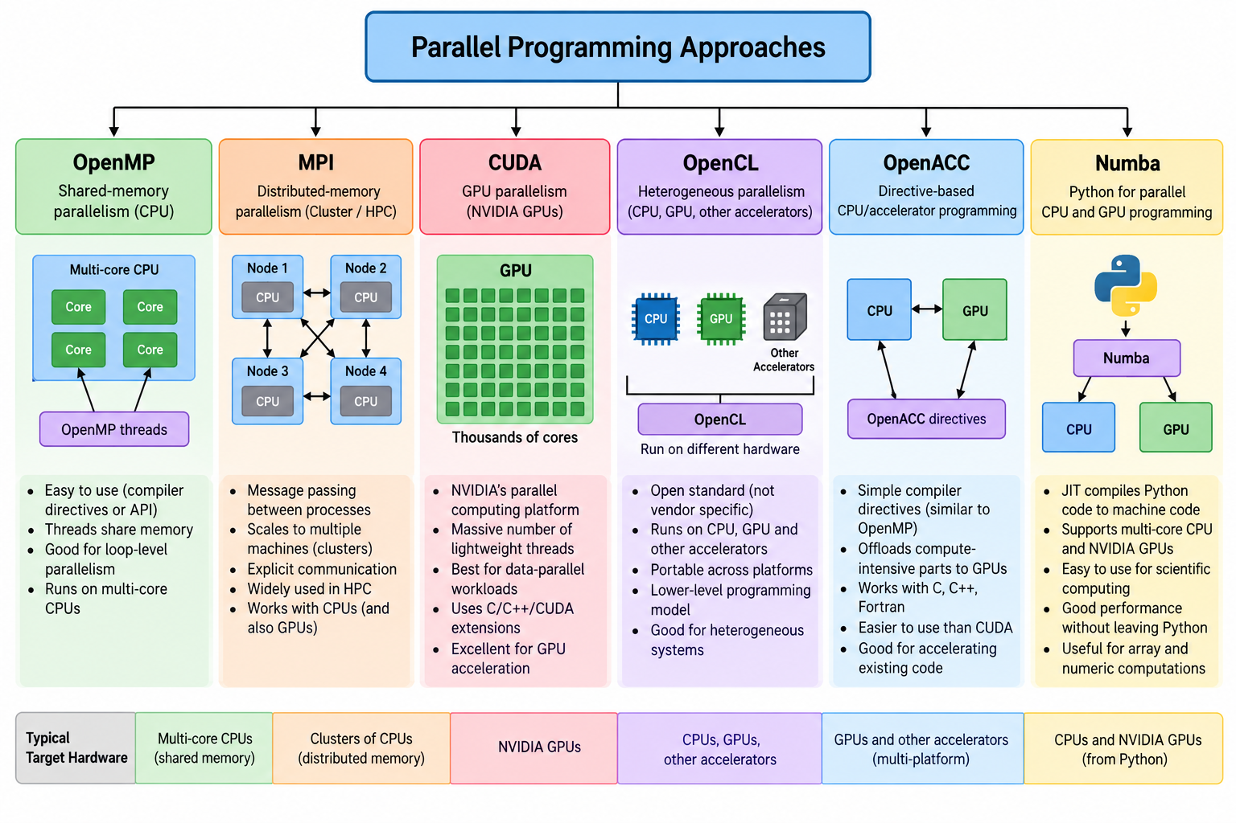

Slide 6
SLIDE 1
Why Parallel Programming?
Parallel programming divides a computational problem into parts that can execute simultaneously.
The goal is to reduce execution time, process larger problems, or improve resource utilization.
Modern CPUs contain multiple cores, making parallel execution a practical programming technique.
Parallelism is useful in scientific computing, simulations, data processing, image processing, and machine learning.

Slide 7
SLIDE 2
Parallel Programming with Modern C++
Modern C++ provides language and library facilities for expressing concurrent and parallel programs.
Important facilities include threads, futures, algorithms, lambda expressions, and standard-library support.
The programmer must consider data sharing, synchronization, dependencies, and workload distribution.
Parallelism should be introduced where the computational workload justifies its overhead.

Slide 8
Usual code
int square(int x) {
return x * x;
}
int main() {
int result = square(10); // run time
}
SLIDE 3
Template Metaprogramming
Template metaprogramming performs computation or generates behavior using C++ templates.
It can move some computation from run time to compile time.
Templates are useful for generic and reusable high-performance code.
Template metaprogramming can become complex; it should be used where it provides a clear benefit.
Code: 02_template_hello.cpp
Using template
template<int N>
struct Square {
static const int value = N * N;
};
int main() {
int result = Square<10>::value; // compile time
}

Slide 9
Usual code
int multiply (int x)
{
return 3 * x;
}
SLIDE 4
Lambda Expressions
A lambda is an anonymous function that can be defined close to where it is used.
Basic form: [capture](parameters) { statements; }
Lambdas are especially useful with standard algorithms and parallel algorithms.
Capture lists determine how variables from the surrounding scope are accessed.
Code: 01_lambda_hello.cpp
Using lambda
#include <cstdio>
int main() {
int factor = 3;
// [factor] -> Means copy 3 into factor inside lambda
auto multiply = [factor](int x) {
return x * factor;
};
printf("multiply(5) = %d\n", multiply(5)); // 15
printf("multiply(7) = %d\n", multiply(7)); // 21
return 0;
}

Slide 10
SLIDE 4
Lambda Expressions – The Parallel Part
The parallelization part
for_each(
std::execution::par, // HOW: parallel execution
v.begin(), v.end(), // WHAT: elements (v = vector)
[](int& x) { // WHAT TO DO
x *= 10;
}
);
Code: 01b_lambda_parallel_stl.cpp

Slide 11
SLIDE 5
Parallel Programming Libraries
Parallel programs can be developed using language features, standard libraries, and dedicated parallel frameworks.
Libraries/frameworks can provide thread management, parallel loops, synchronization, and scheduling.
Choice of library depends on the application, hardware, portability, and required level of control.
Examples in this course include OpenMP and C++ parallel programming facilities.
More threads, faster results? 15_speedup_table.cpp

Slide 12
SLIDE 6
Parallel Program Design
Identify independent parts of the computation.
Divide the workload into tasks or data partitions.
Determine which data is shared and which is private.
Identify dependencies between operations.
Select an appropriate parallelization strategy.
Measure performance and verify correctness.

Slide 13
Module 2 – Parallel Computing Concepts

Slide 14
SLIDE 7
Complexity and Classification
Algorithm complexity describes how computational requirements grow with input size.
Parallel algorithms must consider both computation and communication/synchronization overhead.
A problem may contain serial and parallel portions.
The amount of available parallel work limits the achievable speedup.
02b_complexity_classes.cpp
Complexity | Example | n = 10 | n = 100 | n = 1,000 | Growth
O(1) | Access a[5] | 1 | 1 | 1 | Constant
O(log n) | Binary search | ~3 | ~7 | ~10 | Very slow growth
O(n) | Linear search | 10 | 100 | 1,000 | Proportional to n
O(n log n) | Merge sort | ~33 | ~664 | ~9,966 | Slightly faster growth
O(n²) | Nested loops | 100 | 10,000 | 1,000,000 | Rapid growth
O(2ⁿ) | Recursive subset generation | 1,024 | Extremely large | Impractical | Very rapid growth

Slide 15
SLIDE 8
Speedup
Speedup measures how much faster a parallel program is than a baseline sequential program.
Speedup = Sequential execution time / Parallel execution time.
Ideal speedup with P processors is P, but real programs normally achieve less.
Synchronization, communication, load imbalance, and serial work reduce speedup.

Slide 16
SLIDE 9
Efficiency
Efficiency relates achieved speedup to the number of processing units.
Efficiency = Speedup / Number of processors.
Efficiency close to 1 indicates effective utilization of available processing resources.
Efficiency usually decreases as more processing units are added.

Slide 17
SLIDE 10
Schedules, Job Submission and Batch Systems
Parallel workloads may be executed interactively or through batch systems.
A scheduler allocates computing resources to submitted jobs.
A batch system allows users to specify resource requirements and execution commands.
Resource management includes CPU cores, memory, execution time, and other available resources.

Slide 18
SLIDE 11
Pthreads
Pthreads provides a low-level API for creating and managing threads.
OpenMP provides compiler directives, runtime functions, and environment variables for shared-memory parallelism.
Pthreads offers detailed control but requires more programming effort.
OpenMP allows many parallel patterns to be expressed with relatively small changes to serial C/C++ code. (Next slide)
Code: 05_pthreads_hello.cpp, 13_sum_pthreds.cpp
POSIX threads (Pthreads): Standard C library/API for creating and managing multiple threads within a process
Process: Thread 1 -> Work, Thread 2 -> Work, Thread 3 -> Work
Main function: pthread_create(&thread, NULL, function, argument);
&t: Where thread ID will be stored
NULL: Thread attributes
worker: Function executed by the new thread
NULL: Argument passed to worker()
pthread_join(t, NULL); -> Wait for thread t to finish
To avoid race condition: pthread_mutex_lock and unlock functions
Alternative to OpenMP

Slide 19
SLIDE 11
OpenMP
OpenMP (Open Multi-Processing) is an API for writing shared-memory parallel programs in C, C++, and Fortran
Put the code inside he block #pragma omp parallel
Example
#pragma omp parallel for
for (int i = 0; i < 100; i++)
{
a[i] = a[i] * 2;
}

Slide 20
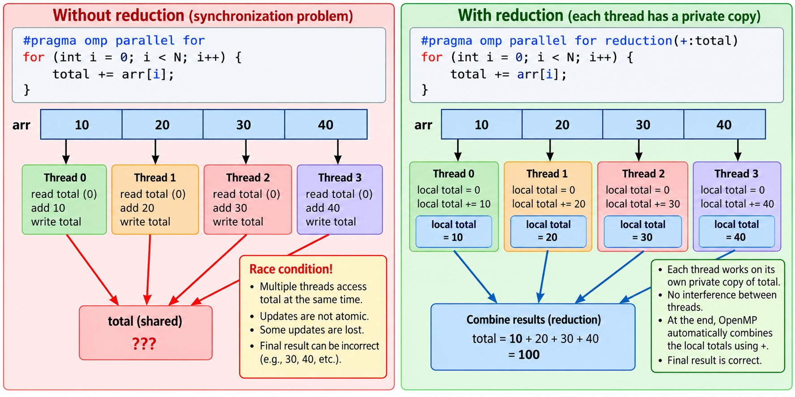
14_sum_openmp.cpp
14b_sum_openmp_reduction.cpp
SLIDE 11
OpenMP - Reduction

Slide 21
SLIDE 12
Numerical Methods and Parallel Applications
Numerical methods often contain repeated computations that can be parallelized.
Examples include numerical integration, iterative methods, matrix operations, and simulation.
Independent iterations can often be executed concurrently.
Dependencies between iterations must be analyzed before parallelization.

Slide 22
SLIDE 13
Parallel Fibonacci
Fibonacci computation provides a simple example for understanding recursive parallelism. (Each number = Sum of the previous two numbers, e.g. 0, 1, 1, 2, 3, 5, 8, 13, …). Rule: F(n) = F(n-1) + F(n-2)
The recursive calls can expose parallel work.
However, creating too many tasks can introduce large overhead.
This example demonstrates the difference between theoretical parallelism and useful parallelism. (Recursion: Not good for parallel work)
Code: 09_fibonacci_serial.cpp and 10_fibonacci_openmp.cpp

Slide 23
SLIDE 14
Incrementing an Array in Parallel
An array operation can be divided among multiple threads.
Each thread processes a separate range of array elements.
If each element is independently updated, synchronization may not be necessary.
This is a simple example of data parallelism.
Run module2_concepts/11_array_increment_serial.cpp and module2_concepts/12_array_increment_openmp.cpp
Then run the 11b and 12b versions
Learning: Just by making code parallel, we may not achieve better performance, but it depends on the task

Slide 24
SLIDE 15
Serial Execution and Fork-Join Algorithms
A fork-join algorithm divides execution into parallel branches and later combines them.
Fork: create parallel work.
Join: wait for parallel work to complete before continuing.
Fork-join is a common pattern in parallel algorithms.
Code: 10b_fork_join_without_join.cpp and 10c_fork_join_with_join.cpp

Slide 25
SLIDE 16
Race Conditions
A race condition occurs when multiple threads access shared data and the final result depends on execution order.
Read-modify-write operations are particularly vulnerable.
Race conditions can produce incorrect and non-deterministic results.
Correct synchronization or redesigned data ownership is required.
24_bank_account_unsynchronized.cpp
Two deposit threads run without synchronization, causing each other’s updates to be lost
25_bank_account_mutex.cpp
Adds synchronization (mutex) variable to guarantee correct balance
26_bank_account_ownership.cpp
No synchronization, but each thread has its own private totaling variable, guaranteeing that threads do not overwrite each other’s totals

Slide 26
SLIDE 17
Synchronization Hardware and the ABA Problem
Synchronization mechanisms coordinate access to shared data.
Atomic operations can perform certain updates without exposing intermediate states.
The ABA problem can occur in lock-free algorithms when a value changes from A to B and back to A.
Correct concurrent algorithm design must account for such subtle cases.

Slide 27
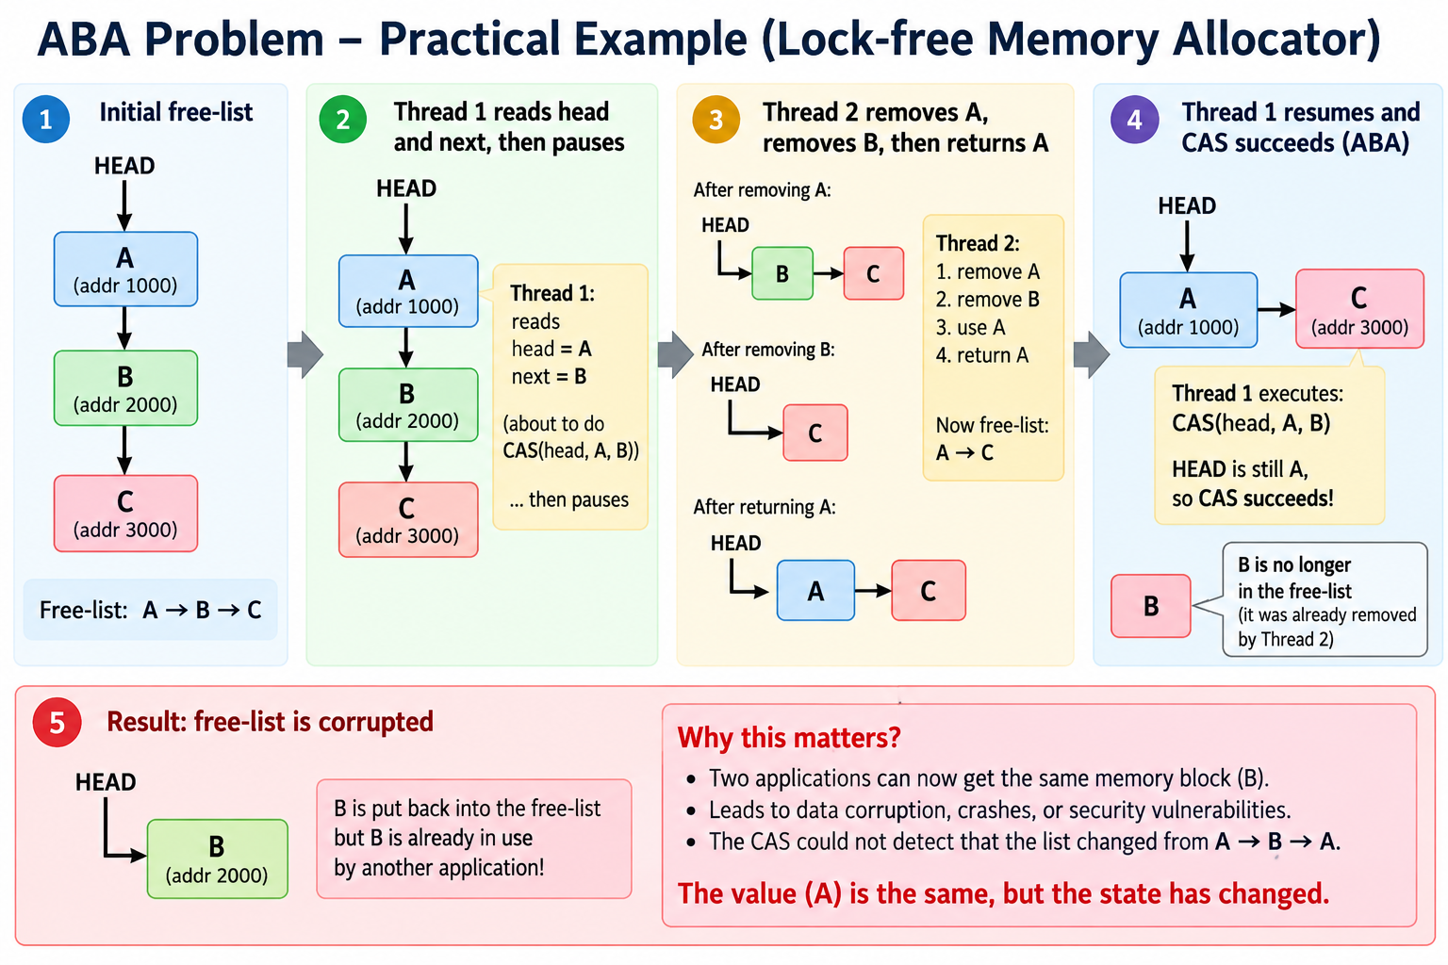

Slide 28
SLIDE 18
Executing Parallel Algorithms
Parallel execution requires identifying independent work and assigning it to execution units.
The number of tasks should be balanced against thread/task creation overhead.
Synchronization should be minimized where safe.
Performance must be measured rather than assumed.

Slide 29
Module 3 – Experimental Work with PASM / Parallel Environment

Slide 30
SLIDE 19
Experimental Setup
Prepare the required source files and compiler environment.
Verify the installed compiler and parallel programming support.
Compile a sequential baseline before creating the parallel version.
Use the supplied make/build mechanism where applicable.

Slide 31
SLIDE 20
Source Files and Software Setup
Identify the main source files used by the experiment.
Keep sequential and parallel versions separately when comparing performance.
Record compiler options and execution parameters.
Ensure the same input data is used for fair comparisons.

Slide 32
SLIDE 21
Makefile and Build Process
A Makefile automates compilation and linking.
It can maintain separate targets for serial and parallel executables.
Compiler flags should enable the required parallel programming support.
Build automation improves repeatability of experiments.

Slide 33
SLIDE 22
Task 1 – Baseline Fibonacci
Implement and execute a sequential Fibonacci program.
Measure execution time for selected input sizes.
Record the result as the baseline for later comparison.
Check correctness before optimizing or parallelizing.

Slide 34
SLIDE 23
Task 2 – Serial Version of Fibonacci
Implement the serial algorithm using a clear and repeatable approach.
Run the program for increasing input sizes.
Record execution time and observe how execution grows.
Use these measurements when evaluating the parallel implementation.

Slide 35
SLIDE 24
Task 3 – Parallel Fibonacci
Identify independent recursive computations.
Create parallel tasks for suitable recursive branches.
Avoid excessive task creation for very small subproblems.
Compare execution time and correctness with the serial version.

Slide 36
SLIDE 25
Measuring Performance with Speedup
Run the same program using different numbers of threads.
Measure execution time for each configuration.
Calculate speedup relative to the sequential baseline.
Plot or tabulate execution time and speedup.

Slide 37
SLIDE 26
Visualizing Processor Utilization
Observe how available processing resources are used during execution.
Look for idle processors, uneven workload distribution, and synchronization overhead.
High processor utilization does not automatically mean good scalability.
Use measurements to explain performance behavior.

Slide 38
SLIDE 27
Strong and Weak Scaling
Strong scaling: keep the problem size fixed and increase the number of processing units.
Weak scaling: increase the problem size as the number of processing units increases.
Strong scaling examines how quickly a fixed problem can be solved.
Weak scaling examines whether the system can maintain performance as workload grows.

Slide 39
Module 4 – Work Efficiency and Granularity

Slide 40
SLIDE 28
Improving Work Efficiency
Parallelization introduces overhead in addition to useful computation.
Work efficiency improves when processors spend more time performing useful work.
Reduce unnecessary synchronization, communication, and task creation.
Balance workload across processing units.

Slide 41
SLIDE 29
Granularity
Granularity describes the amount of computation performed by each parallel task.
Fine-grained tasks contain relatively little computation.
Coarse-grained tasks contain more computation.
Very fine-grained parallelism may suffer from scheduling and synchronization overhead.

Slide 42
SLIDE 30
Determining the Threshold
Recursive and task-based algorithms often need a threshold below which work executes sequentially.
Large subproblems can be parallelized.
Small subproblems may be faster sequentially.
Experiment with threshold values and measure the effect on execution time.
Code: 16_mergesort_threshold.cpp

Slide 43
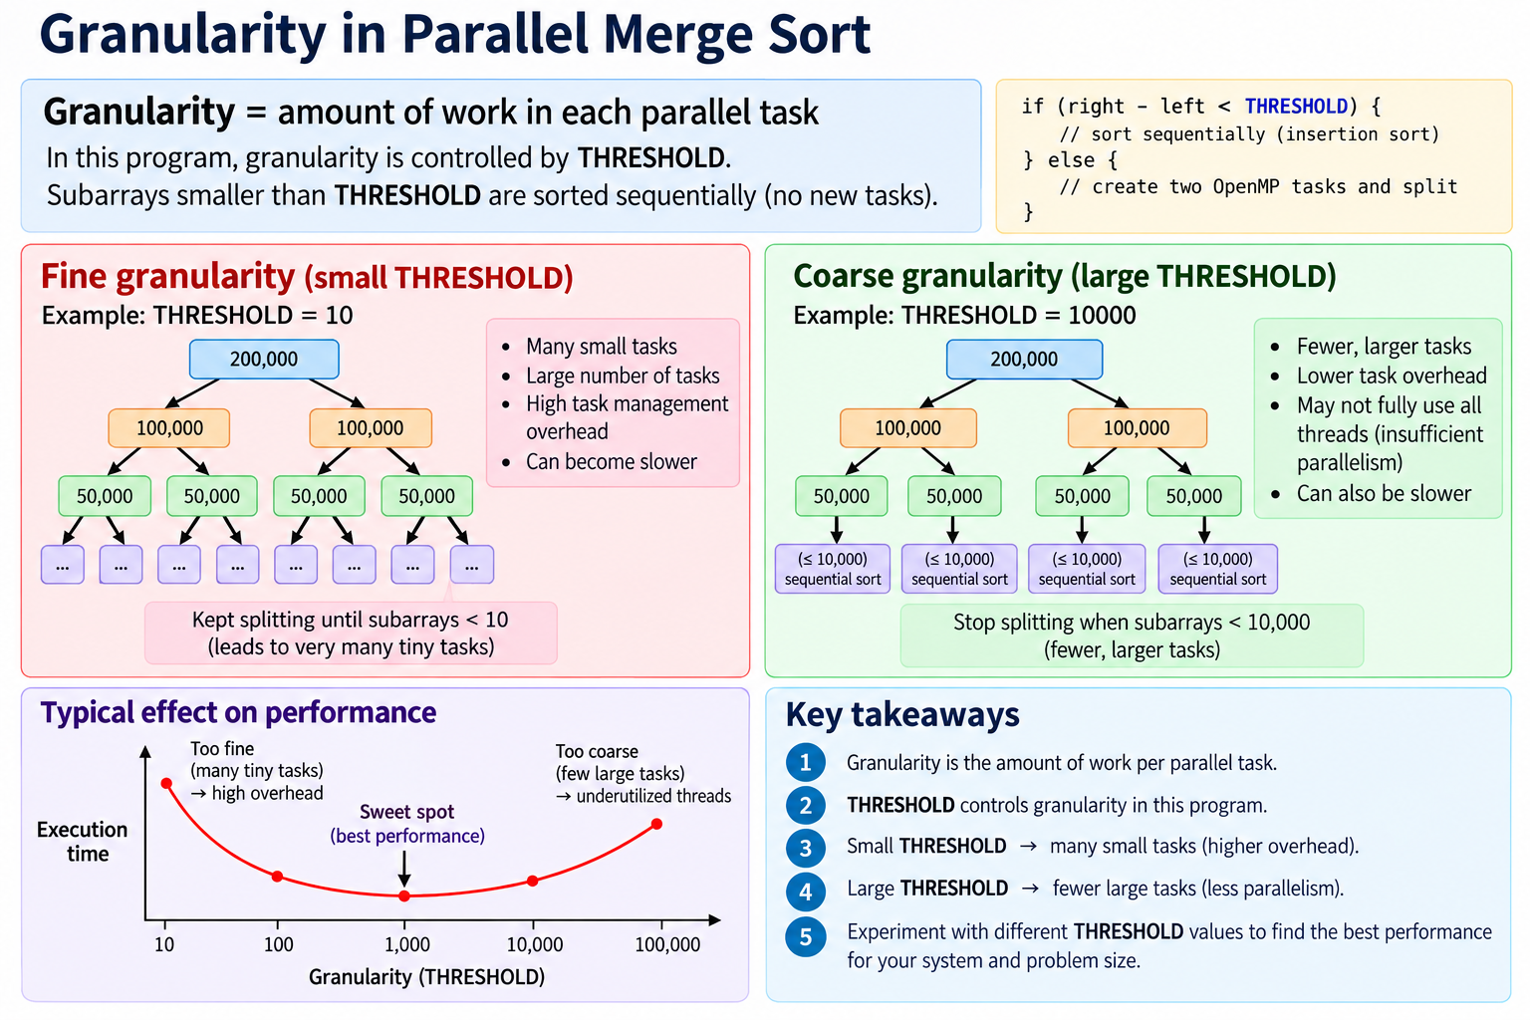

Slide 44
SLIDE 31
Domain Granularity Control
Partition the problem domain into chunks that can be processed independently.
Choose a chunk size that balances workload and overhead.
Static partitioning can be effective when workloads are uniform.
Dynamic scheduling can help when workloads vary.

Slide 45
SLIDE 32
Complex Functions and Nested Parallelism
Complex functions may contain several levels of computation.
Nested parallelism introduces parallel regions inside other parallel regions.
Too many levels of parallelism can oversubscribe the available hardware.
Use nested parallelism only when the workload justifies it.

Slide 46
SLIDE 33
Controlled Parallel-For Loops
Parallel-for distributes loop iterations across multiple workers.
Iterations should ideally be independent.
The scheduling strategy affects load balance and overhead.
Loop-carried dependencies must be identified before parallelization.

Slide 47
Module 5 – Simple Parallel Algorithms and Concurrency

Slide 48
SLIDE 34
Interface and Cost Model
A parallel algorithm should expose enough independent work to keep processing units busy.
The cost model includes computation, communication, synchronization, and scheduling.
The fastest theoretical algorithm may not be the fastest implementation on real hardware.
Performance analysis should consider the complete execution path.

Slide 49
SLIDE 35
Allocation and Deallocation
Dynamic memory allocation can become expensive in heavily parallel programs.
Frequent allocation and deallocation may introduce contention and overhead.
Prefer appropriate data ownership and reuse where possible.
Avoid unnecessary sharing of mutable memory.

Slide 50
SLIDE 36
Passing To and Returning From Functions
Parallel functions should clearly define input, output, and shared state.
Avoid accidental sharing of writable variables.
Return values or explicit output buffers can make ownership clearer.
Function interfaces should make concurrency assumptions understandable.

Slide 51
SLIDE 37
High-Level Granularity Control
High-level parallel constructs allow programmers to control the amount of work assigned to workers.
Task size should be large enough to amortize scheduling overhead.
Granularity can be adjusted experimentally.
Performance should be evaluated using representative workloads.

Slide 52
SLIDE 38
Reduction
Reduction combines multiple partial results into one final result.
Examples include sum, product, minimum, and maximum.
Each worker can compute a local result before the results are combined.
Reduction avoids unnecessary simultaneous updates to a shared variable.

Slide 53
SLIDE 39
Scan
A scan computes prefix results over a sequence.
Inclusive scan includes the current element; exclusive scan uses preceding elements.
Scan is useful in parallel algorithms such as indexing, partitioning, and cumulative computation.
Parallel scan requires careful handling of dependencies.

Slide 54
SLIDE 40
Divide Operations
Divide-and-conquer algorithms split a problem into smaller subproblems.
Independent subproblems can execute in parallel.
Results are combined after the subproblems finish.
Examples include recursive sorting and searching techniques.

Slide 55
SLIDE 41
Parallel Sorting
Sorting can be parallelized by dividing data and processing partitions concurrently.
Parallel sorting strategies include divide-and-conquer and partition-based approaches.
Performance depends on partition quality, memory behavior, and synchronization.
Compare parallel and sequential implementations using the same data.

Slide 56
SLIDE 42
Parallel Search
Search can distribute different portions of a collection among workers.
Workers can search independently when there are no conflicting updates.
The algorithm must define how and when a result is communicated.
For large datasets, memory access behavior can strongly affect performance.

Slide 57
Module 6 – Parallelism, Concurrency and Race Conditions

Slide 58
SLIDE 43
Parallelism vs Concurrency
Concurrency means multiple activities are in progress during overlapping periods.
Parallelism means multiple computations actually execute simultaneously.
A concurrent program may run on one processor through interleaving.
Parallel execution requires multiple execution resources.

Slide 59
SLIDE 44
Race Conditions and Concurrency
Concurrent access to shared mutable data can produce race conditions.
The result may vary between executions.
The problem is caused by an unsafe ordering of accesses.
Use synchronization, atomic operations, or redesigned data ownership to eliminate the race.

Slide 60
SLIDE 45
Eliminating Race Conditions by Synchronization
Synchronization establishes safe ordering between conflicting operations.
Locks/mutexes can protect critical sections.
Atomic operations can safely update suitable shared variables.
Synchronization should be limited to what is necessary because it can reduce parallel performance.

Slide 61
SLIDE 46
Critical Section
A critical section is a portion of code that accesses shared resources and must be protected.
Only the required operations should be placed inside the critical section.
Large critical sections reduce parallelism.
The design goal is correctness with minimal synchronization overhead.

Slide 62
SLIDE 47
Atomic Operations
Atomic operations execute as indivisible operations from the perspective of other threads.
They are useful for counters, flags, and other simple shared-state updates.
Atomic operations can avoid some lock overhead.
Not every complex operation can be safely replaced by a single atomic operation.

Slide 63
Hands-on Lab – Suggested Sequence

Slide 64
LAB 1
Sequential Baseline
Compile and run a sequential Fibonacci program.
Measure execution time.
Record results for several input sizes.
Verify output correctness.

Slide 65
LAB 2
Parallel Fibonacci
Create a parallel version using an appropriate task/fork-join approach.
Compile with the required parallel support.
Run using different numbers of threads.
Compare execution time with the baseline.

Slide 66
LAB 3
Array Increment
Create a large array.
Increment each element sequentially.
Parallelize the loop.
Compare execution time and verify the final array.

Slide 67
LAB 4
Race Condition Demonstration
Create multiple threads that increment a shared counter.
Run without synchronization and observe inconsistent results.
Protect the update using an appropriate synchronization mechanism.
Run again and compare correctness and performance.

Slide 68
LAB 5
Reduction
Compute the sum of a large array sequentially.
Divide the array among workers.
Compute local sums.
Combine local sums into the final result.
Compare performance.

Slide 69
LAB 6
Granularity Experiment
Run a task-based program with different task-size thresholds.
Measure execution time for each threshold.
Observe the effect of task creation overhead.
Identify a practical threshold for the selected workload.

Slide 70
LAB 7
Speedup and Efficiency
Run the program with 1, 2, 4, 8 or available processing units.
Record execution times.
Calculate speedup and efficiency.
Explain why measured speedup differs from ideal speedup.

Slide 71
LAB 8
Strong Scaling
Keep the problem size fixed.
Increase the number of workers.
Record execution time, speedup, and efficiency.
Explain the point at which additional workers provide diminishing benefits.

Slide 72
LAB 9
Parallel Sorting/Search
Implement or use a parallel sorting/search approach.
Compare against a sequential implementation.
Use identical input data.
Measure execution time and verify results.

Slide 73
LAB 10
Final Performance Study
Select one parallel algorithm.
Measure serial and parallel execution.
Experiment with worker count and granularity.
Record speedup and efficiency.
Explain observed performance using computation, synchronization, and overhead.

Slide 74
Key Takeaways

Slide 75
Key Takeaways
Parallel programming is not simply 'adding more threads'; the algorithm and data dependencies must support parallel execution.
Correctness comes first: race conditions and synchronization errors must be addressed.
Speedup and efficiency provide quantitative measures of parallel performance.
Granularity and workload balance strongly influence performance.
The best way to understand parallel programming is to implement, measure, and compare sequential and parallel versions.

